Slide 1
Team GVSU Milestone #2
Team: Chris Schaefer, Laura Young and Chad Mersino

Slide 2
Experience Meeting with FFPAC
Attended a portion of a FFPAC meeting and showed the whole committee the project so far
Received a decent sized list of features of ideas they wanted to see implemented
Personally viewed how this project affects the individuals on the walkthrough
Able to discuss higher level concepts to individuals who are not in the computing field in a way for them to understand
Elaborated on our personal expectations with the project in comparison to their desires for the application and settled these differences in a professional manner

Slide 3
Features Implemented in Milestone #2
Overall theme change
Removed redundant pages
Implemented Survey link
Added attributes page
Changed values in drop down menus to represent room names
Entered attributes into data page
Display complaint date insert
Extra field to indicate a major renovation (long term)

Slide 4
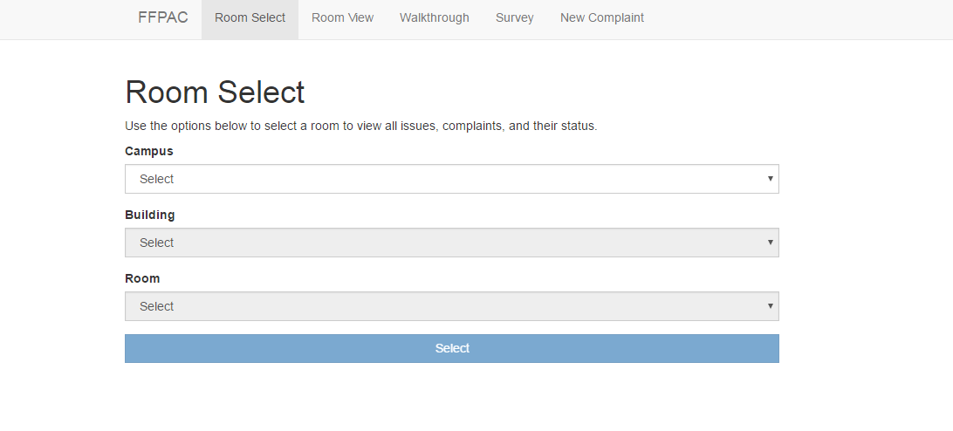
Previous Site

Slide 5
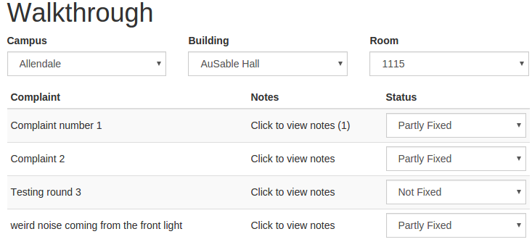
Previous Walkthrough

Slide 6
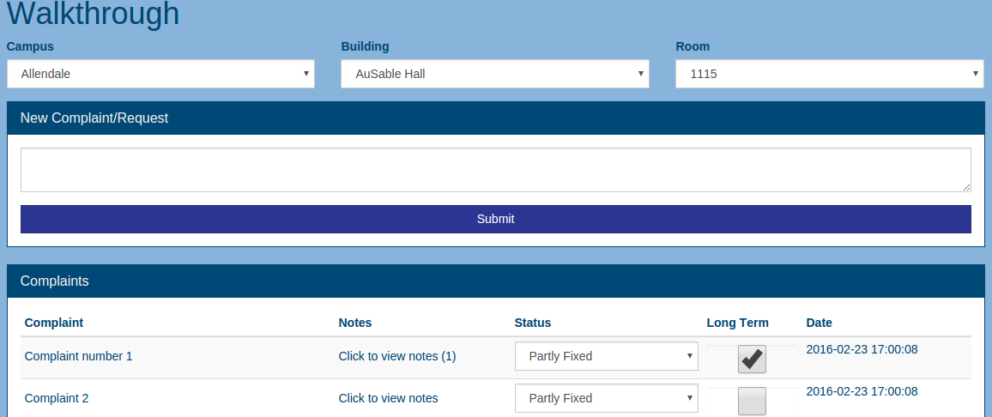
Current Walkthrough

Slide 7
Setbacks During Development
Getting this onto GVSU servers for the customers and professor to test
Spring break
No downtown campus information given so far, still waiting for that to be finalized
Some features clients wanted but are in question
Map layout of building for room selection
User accounts via email
Connecting existing databases from maintenance and faculty
Create a use session before adding collected data to main database
Notes:
Map layout of building (security issue, necessary?)
User accounts via email, only GVSU faculty/staff can access (we can make admins) notification system

Slide 8
Projected Progress for Milestone #3
Leaderboard of classroom with most issues or complaints
User accounts for FFPAC members
Keyword search features to generalize the similar problem and look for any connections between buildings and problems
Allow for user to attach files relating to complaint
If a complaint needs immediate attention, allow for a field to automatically notify the correct individuals to fix the problem
Issues not pertaining to a specific room but to a general area in a building
Develop more unit testing
Get site on a working server (Amazon EC2?)

